Slide 1




SRM INSTITUTE OF SCIENCE AND TECHNOLOGY, CHENNAI.
18CSC205J-Operating Systems
Unit- I

Slide 2

SRM INSTITUTE OF SCIENCE AND TECHNOLOGY,CHENNAI.
UNIT I SYLLABUS
Operating System Objectives and functions - Gaining the role of Operating systems - The evolution of operating system, Major Achievements - Understanding the evolution of Operating systems from early batch processing systems to modern complex systems - Process Concept– Processes, PCB - Understanding the Process concept and Maintenance of PCB by OS -Threads – Overview and its Benefits - Understanding the importance of threads - Process Scheduling : Scheduling Queues, Schedulers, Context switch - Understanding basics of Process Scheduling - Operations on Process – Process creation, Process termination - Understanding the system calls – fork(),wait(),exit() - Inter Process communication : Shared Memory, Message Passing ,Pipe() -Understanding the need for IPC - Process synchronization: Background, Critical section Problem - Understanding the race conditions and the need for the Process synchronization

Slide 3
SRM INSTITUTE OF SCIENCE AND TECHNOLOGY,CHENNAI.
Contents:
1.OS Objectives and functions
2. Evolution of OS
– Serial Processing
– Batch processing
– Multi programming
– Time sharing
Major advances in development of OS : Process, Memory, Security & Resource Sharing
3. OS Design issues for multiprocessor and multi core OS

Slide 4
SRM INSTITUTE OF SCIENCE AND TECHNOLOGY,CHENNAI.
4. Process
– Process states
– PCB
– Process Creation, fork(), wait(), exit()
– IPC – Pipe, Message Queue, Shared Memory (System V / Posix)
– Thread overview and benefits
5. Process Scheduling
– Scheduling Queues
– Schedulers
– Context Switch
6. Process Synchronization
– Basic
– Race Condition
– Critical Section

Slide 5
SRM INSTITUTE OF SCIENCE AND TECHNOLOGY,CHENNAI.
Operating System
Operating systems are those programs that interface the machine with
the applications programs. The main function of these systems is to
dynamically allocate the shared system resources to the executing
programs.
A program that controls the execution of application programs
An interface between applications and hardware
Main objectives of an OS:
Convenience
Efficiency
Ability to evolve

Slide 6
Operating System Services
SRM INSTITUTE OF SCIENCE AND TECHNOLOGY,CHENNAI.
Program development
Program execution
Access I/O devices
Controlled access to files
System access
Error detection and response
Accounting

Slide 7
SRM
INSTITUTE OF SCIENCE AND TECHNOLOGY,
CHENNAI.
Role of Operating System :
The OS as a User/Computer Interface
Computer Hardware-Software Structure
Layered organization
OS services to users

Slide 8
The Operating System as a Resource Manager
SRM
INSTITUTE OF SCIENCE AND TECHNOLOGY,
CHENNAI.
A computer is a set of resources for moving, storing, & processing data
The OS is responsible for managing these resources
The OS exercises its control through software

Slide 9
SRM
INSTITUTE OF SCIENCE AND TECHNOLOGY,
CHENNAI.
Operating System as Software
Functions in the same way as ordinary computer software
Program, or suite of programs, executed by the processor
Frequently relinquishes control and must depend on the processor to allow it to regain control

Slide 10
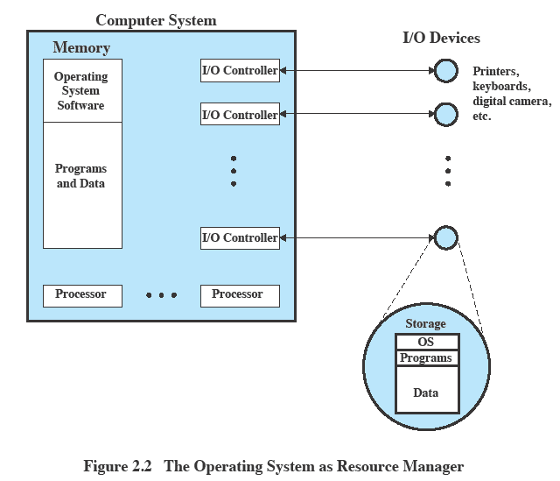
SRM
INSTITUTE OF SCIENCE AND TECHNOLOGY,
CHENNAI.
Operating System as Resource Manager

Slide 11
SRM
INSTITUTE OF SCIENCE AND TECHNOLOGY,
CHENNAI.
Evolution of Operating Systems
A major OS will evolve over time for a number of reasons:
Hardware upgrades
New types of hardware
New services
Fixes

Slide 12
SRM
INSTITUTE OF SCIENCE AND TECHNOLOGY,
CHENNAI.
Stages Include…
Time Sharing Systems
Multiprogrammed Batch Systems
Simple Batch Systems
Serial Processing

Slide 13
SRM
INSTITUTE OF SCIENCE AND TECHNOLOGY,
CHENNAI.
Serial Processing
Earliest Computers:
Problems:
No operating system
Programmers interacted directly
with the computer hardware
Computers ran from a console with display lights, toggle switches, some form of input device, and a printer
Users have access to the computer in “series”
Scheduling:
Most installations used a hardcopy sign-up sheet to reserve computer time.
Time allocations could run short or long, resulting in wasted computer time
Setup time
A considerable amount of time was spent just on setting up the program to run

Slide 14
SRM
INSTITUTE OF SCIENCE AND TECHNOLOGY,
CHENNAI.
Simple Batch Systems
Early computers were very expensive
Important to maximize processor utilization
Monitor
User no longer has direct access to processor
Job is submitted to computer operator who batches them together and places them on an input device
Program branches back to the monitor when finished

Slide 15
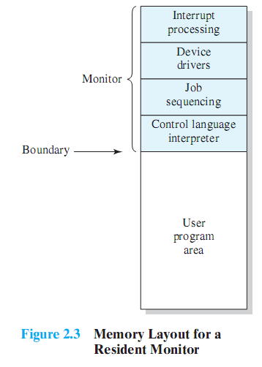
Monitor Point of View
Monitor controls the sequence of events
Resident Monitor is software always in memory
Monitor reads in job and gives control
Job returns control to monitor

Slide 16
Processor Point of View
Processor executes instruction from the memory containing the monitor
Executes the instructions in the user program until it encounters an ending or error condition
“control is passed to a job” means processor is fetching and executing instructions in a user program
“control is returned to the monitor” means that the processor is fetching and executing instructions from the monitor program

Slide 17
SRM
INSTITUTE OF SCIENCE AND TECHNOLOGY,
CHENNAI.
Modes of Operation
User Mode
User program executes in user mode
Certain areas of memory are protected from user access
Certain instructions may not be executed
Kernel Mode
Monitor executes in kernel mode
Privileged instructions may be executed
Protected areas of memory may be accessed

Slide 18
SRM
INSTITUTE OF SCIENCE AND TECHNOLOGY,
CHENNAI.
Simple Batch System Overhead
Processor time alternates between execution of user programs and execution of the monitor
Sacrifices:
some main memory is now given over to the monitor
some processor time is consumed by the monitor
Despite overhead, the simple batch system improves utilization of the computer. (How?)

Slide 19
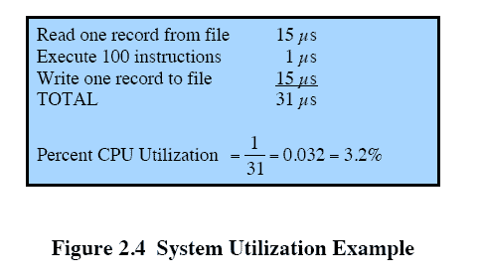
SRM
INSTITUTE OF SCIENCE AND TECHNOLOGY,
CHENNAI.
Multi programmed Batch Systems
Processor is often idle
Even with automatic job sequencing
I/O devices are slow compared to processor

Slide 20

SRM
INSTITUTE OF SCIENCE AND TECHNOLOGY,
CHENNAI.
Uniprogramming
The processor spends a certain amount of time executing, until it reaches an I/O instruction; it must then wait until that I/O instruction concludes before proceeding

Slide 21
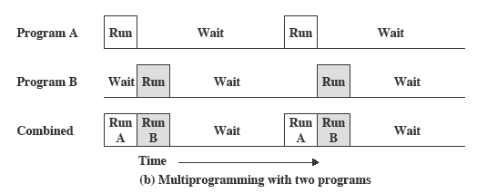
SRM
INSTITUTE OF SCIENCE AND TECHNOLOGY,
CHENNAI.
Multiprogramming
There must be enough memory to hold the OS (resident monitor) and one user program
When one job needs to wait for I/O, the processor can switch to the other job, which is likely not waiting for I/O

Slide 22
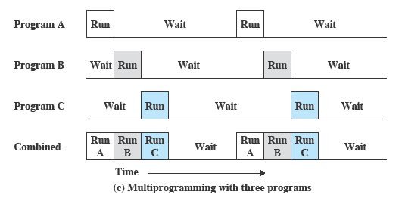
SRM
INSTITUTE OF SCIENCE AND TECHNOLOGY,
CHENNAI.
Multiprogramming
Multiprogramming
also known as multitasking
memory is expanded to hold three, four, or more programs and switch among all of them

Slide 23
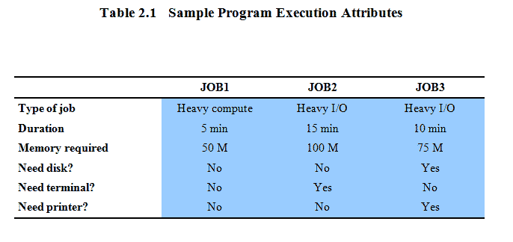
SRM
INSTITUTE OF SCIENCE AND TECHNOLOGY,
CHENNAI.
Multiprogramming Example

Slide 24
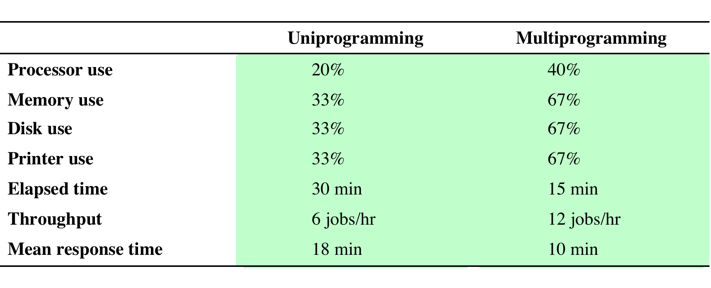
SRM
INSTITUTE OF SCIENCE AND TECHNOLOGY,
CHENNAI.
Effects on Resource Utilization
Table 2.2 Effects of Multiprogramming on Resource Utilization

Slide 25
SRM
INSTITUTE OF SCIENCE AND TECHNOLOGY,
CHENNAI.
Time-Sharing Systems
Can be used to handle multiple interactive jobs
Processor time is shared among multiple users
Multiple users simultaneously access the system through terminals, with the OS interleaving the execution of each user program in a short burst or quantum of computation

Slide 26
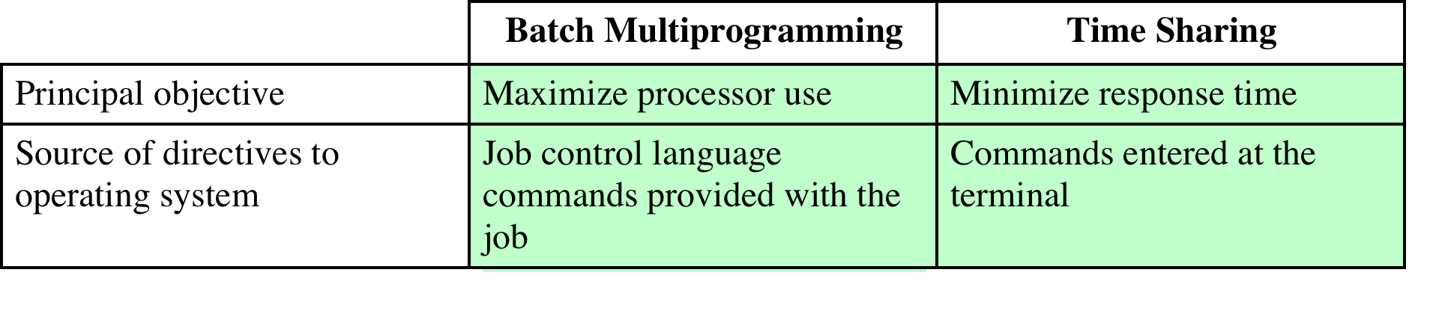
SRM
INSTITUTE OF SCIENCE AND TECHNOLOGY,
CHENNAI.
Batch Multiprogramming vs. Time Sharing
Table 2.3 Batch Multiprogramming versus Time Sharing

Slide 27
Compatible Time-Sharing Systems
SRM
INSTITUTE OF SCIENCE AND TECHNOLOGY,
CHENNAI.
CTSS
Time Slicing
System clock generates interrupts at a rate of approximately one every 0.2 seconds
At each interrupt OS regained control and could assign processor to another user
At regular time intervals the current user would be preempted and another user loaded in
Old user programs and data were written out to disk
Old user program code and data were restored in main memory when that program was next given a turn
One of the first time-sharing operating systems
Developed at MIT by a group known as Project MAC
Ran on a computer with 32,000 36-bit words of main memory, with the resident monitor consuming 5000 of that
To simplify both the monitor and memory management a program was always loaded to start at the location of the 5000th word

Slide 28
SRM
INSTITUTE OF SCIENCE AND TECHNOLOGY,
CHENNAI.
Major Advances
Operating Systems are among the most complex pieces of software ever developed
Major advances in development include:
Processes
Memory management
Information protection and security
Scheduling and resource management
System structure

Slide 29
SRM
INSTITUTE OF SCIENCE AND TECHNOLOGY,
CHENNAI.
Process
Fundamental to the structure of operating systems
A process can be defined as:
a program in execution
an instance of a running program
the entity that can be assigned to, and executed on, a processor
a unit of activity characterized by a single sequential thread of execution, a current state, and an associated set of system resources

Slide 30
SRM
INSTITUTE OF SCIENCE AND TECHNOLOGY,
CHENNAI.
Development of the Process
Three major lines of computer system development created problems in timing and synchronization that contributed to the development:
multiprogramming batch operation
processor is switched among the various programs residing in main memory
time sharing
be responsive to the individual user but be able to support many users simultaneously
real-time transaction systems
a number of users are entering queries or updates against a database

Slide 31
SRM
INSTITUTE OF SCIENCE AND TECHNOLOGY,
CHENNAI.
Components of a Process
A process contains three components:
An executable program
The associated data needed by the program (variables, work space, buffers, etc.)
The execution context (or “process state”) of the program
The execution context is essential:
It is the internal data by which the OS is able to supervise and control the process
Includes the contents of the various process registers
Includes information such as the priority of the process and whether the process is waiting for the completion of a particular I/O event

Slide 32
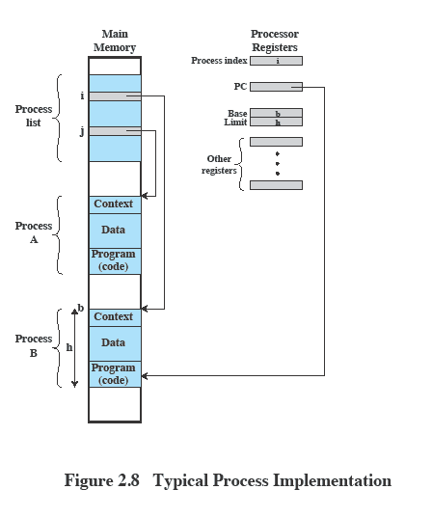
SRM
INSTITUTE OF SCIENCE AND TECHNOLOGY,
CHENNAI.
Process Management
The entire state of the process at any instant is contained in its context
New features can be designed and incorporated into the OS by expanding the context to include any new information needed to support the feature

Slide 33
SRM
INSTITUTE OF SCIENCE AND TECHNOLOGY,
CHENNAI.
Memory Management
The OS has five principal storage management responsibilities:
process isolation
automatic allocation and management
support of modular programming
protection and access control
long-term storage

Slide 34
SRM
INSTITUTE OF SCIENCE AND TECHNOLOGY,
CHENNAI.
Memory Management (contd..)
VIRTUAL MEMORY
A facility that allows programs to address memory from a logical point of view, without regard to the amount of main memory physically available
Conceived to meet the requirement of having multiple user jobs reside in main memory concurrently
PAGING
Allows processes to be comprised of a number of fixed-size blocks, called pages
Program references a word by means of a virtual address
consists of a page number and an offset within the page
each page may be located anywhere in main memory
Provides for a dynamic mapping between the virtual address used in the program and a real (or physical) address in main memory

Slide 35
SRM
INSTITUTE OF SCIENCE AND TECHNOLOGY,
CHENNAI.
Information Protection and Security
The nature of the threat that concerns an organization will vary greatly depending on the circumstances
The problem involves controlling access to computer systems and the information stored in them
Main issues
availability
authenticity
confidentiality
data integrity

Slide 36
SRM
INSTITUTE OF SCIENCE AND TECHNOLOGY,
CHENNAI.
Scheduling and Resource Management
Key responsibility of an OS is managing resources
Resource allocation policies must consider:
efficiency
fairness
differential responsiveness

Slide 37
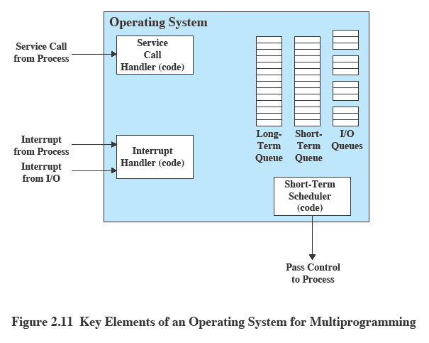
SRM
INSTITUTE OF SCIENCE AND TECHNOLOGY,
CHENNAI.
Key Elements of an Operating System

Slide 38
OS Design
SRM
INSTITUTE OF SCIENCE AND TECHNOLOGY,
CHENNAI.
Distributed Operating System
Object-Oriented Design
Provides the illusion of
a single main memory space
single secondary memory space
unified access facilities
State of the art for distributed operating systems lags that of uniprocessor and SMP operating systems
Used for adding modular extensions to a small kernel
Enables programmers to customize an operating system without disrupting system integrity
Eases the development of distributed tools and full-blown distributed operating systems

Slide 39
SRM
INSTITUTE OF SCIENCE AND TECHNOLOGY,
CHENNAI.
Symmetric Multiprocessor OS Considerations
A multiprocessor OS must provide all the functionality of a multiprogramming system plus additional features to accommodate multiple processors
Key design issues:
Simultaneous concurrent processes or threads
Scheduling
Synchronization
Memory management
Reliability and fault tolerance
any processor may perform scheduling, which complicates the task of enforcing a scheduling policy
the reuse of physical pages is the biggest problem of concern
with multiple active processes having potential access to shared address spaces or shared I/O resources, care must be taken to provide effective synchronization
kernel routines need to be reentrant to allow several processors to execute the same kernel code simultaneously
the OS should provide graceful degradation in the face of processor failure

Slide 40
SRM
INSTITUTE OF SCIENCE AND TECHNOLOGY,
CHENNAI.
Multicore OS Considerations
The design challenge for a many-core multicore system is to efficiently harness the multicore processing power and intelligently manage the substantial on-chip resources efficiently
Potential for parallelism exists at three levels:
hardware parallelism within each core processor, known as instruction level parallelism
potential for multiprogramming and multithreaded execution within each processor
potential for a single application to execute in concurrent processes or threads across multiple cores

Slide 41
SRM
INSTITUTE OF SCIENCE AND TECHNOLOGY,
CHENNAI.
Process
Process Concept and States
PCB
Process Scheduling
Operations on Processes
Interprocess Communication
Examples of IPC Systems

Slide 42
SRM
INSTITUTE OF SCIENCE AND TECHNOLOGY,
CHENNAI.
Objectives
To introduce the notion of a process -- a program in execution, which forms the basis of all computation
To describe the various features of processes, including scheduling, creation and termination, and communication
To explore interprocess communication using shared memory and message passing
To describe communication in client-server systems

Slide 43
SRM
INSTITUTE OF SCIENCE AND TECHNOLOGY,
CHENNAI.
Process Concept
An operating system executes a variety of programs:
Batch system – jobs
Time-shared systems – user programs or tasks
Textbook uses the terms job and process almost interchangeably
Process – a program in execution; process execution must progress in sequential fashion
Multiple parts
The program code, also called text section
Current activity including program counter, processor registers
Stack containing temporary data
Function parameters, return addresses, local variables
Data section containing global variables
Heap containing memory dynamically allocated during run time

Slide 44
SRM
INSTITUTE OF SCIENCE AND TECHNOLOGY,
CHENNAI.
Program is passive entity stored on disk (executable file), process is active
Program becomes process when executable file loaded into memory
Execution of program started via GUI mouse clicks, command line entry of its name, etc
One program can be several processes
Consider multiple users executing the same program

Slide 45
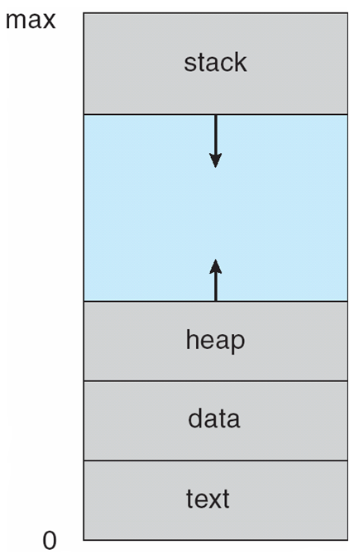
SRM
INSTITUTE OF SCIENCE AND TECHNOLOGY,
CHENNAI.
Process in Memory

Slide 46
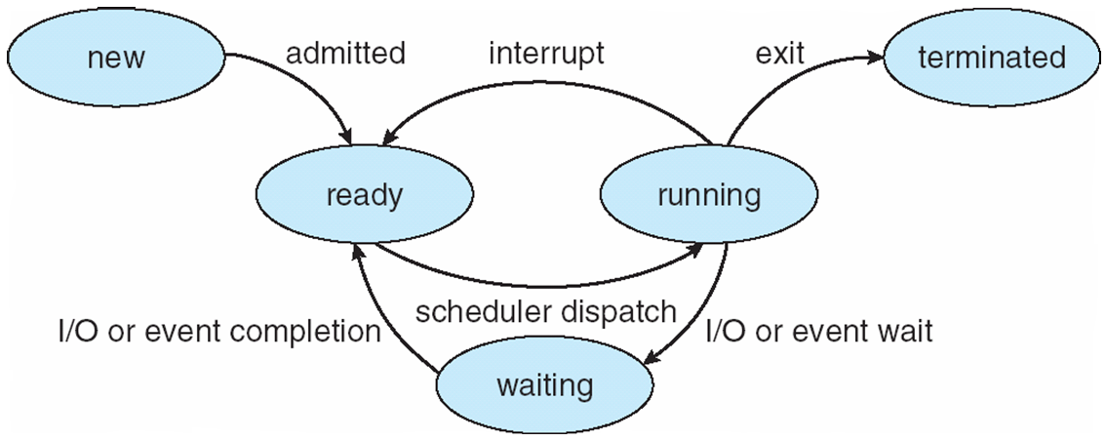
SRM
INSTITUTE OF SCIENCE AND TECHNOLOGY,
CHENNAI.
Diagram of Process State

Slide 47
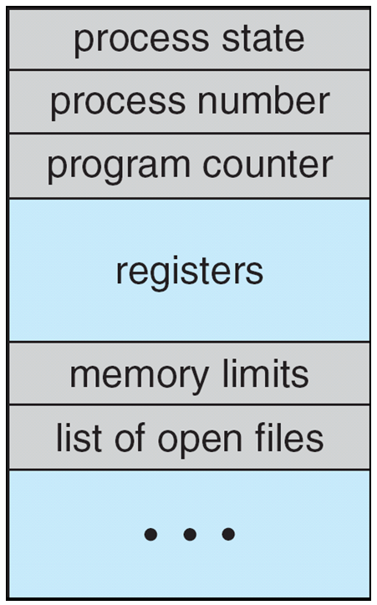
SRM
INSTITUTE OF SCIENCE AND TECHNOLOGY,
CHENNAI.
Process Control Block (PCB)
Information associated with each process
(also called task control block)
Process state – running, waiting, etc
Program counter – location of instruction to next execute
CPU registers – contents of all process-centric registers
CPU scheduling information- priorities, scheduling queue pointers
Memory-management information – memory allocated to the process
Accounting information – CPU used, clock time elapsed since start, time limits
I/O status information – I/O devices allocated to process, list of open files

Slide 48
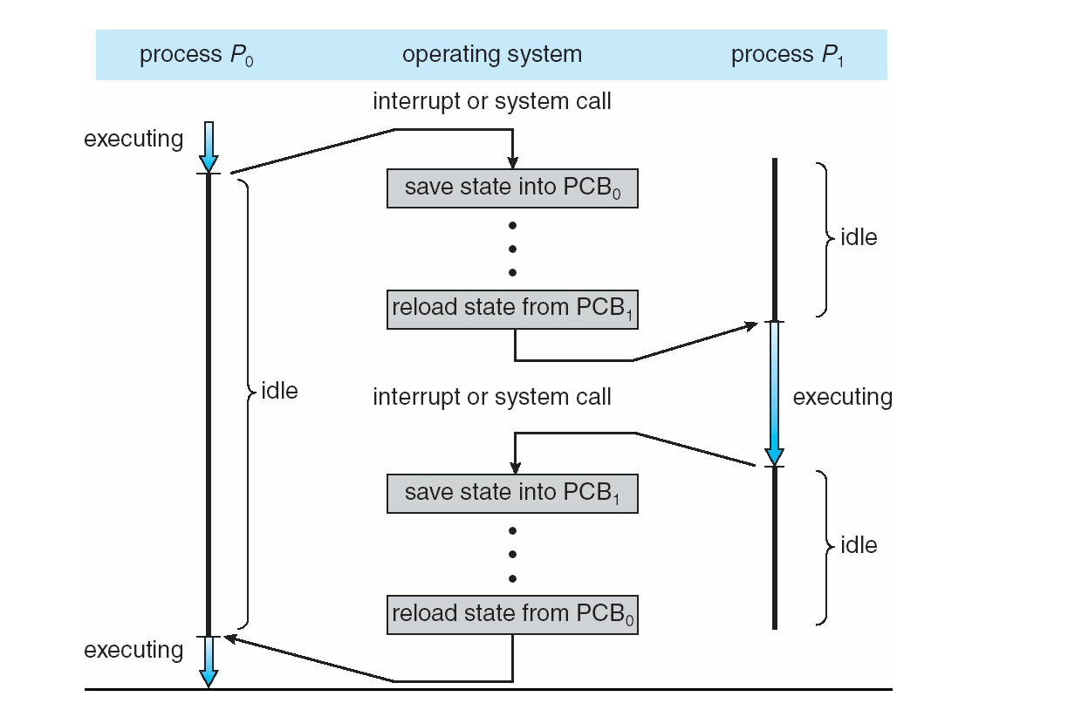
SRM
INSTITUTE OF SCIENCE AND TECHNOLOGY,
CHENNAI.
CPU Switch From Process to Process

Slide 49
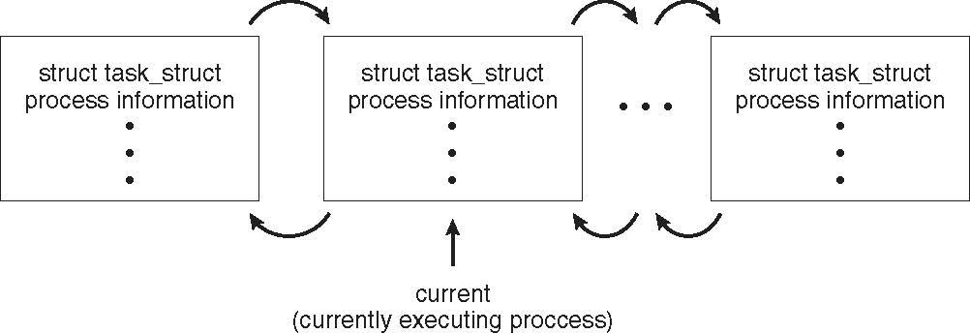
SRM
INSTITUTE OF SCIENCE AND TECHNOLOGY,
CHENNAI.
Process Representation in Linux
Represented by the C structure task_struct
pid t_pid; /* process identifier */ long state; /* state of the process */ unsigned int time_slice /* scheduling information */ struct task_struct *parent; /* this process’s parent */ struct list_head children; /* this process’s children */ struct files_struct *files; /* list of open files */ struct mm_struct *mm; /* address space of this process */

Slide 50
SRM
INSTITUTE OF SCIENCE AND TECHNOLOGY,
CHENNAI.
Threads
So far, process has a single thread of execution
Consider having multiple program counters per process
Multiple locations can execute at once
Multiple threads of control -> threads
Must then have storage for thread details, multiple program counters in PCB
See next chapter

Slide 51
SRM
INSTITUTE OF SCIENCE AND TECHNOLOGY,
CHENNAI.
Process Scheduling
Maximize CPU use, quickly switch processes onto CPU for time sharing
Process scheduler selects among available processes for next execution on CPU
Maintains scheduling queues of processes
Job queue – set of all processes in the system
Ready queue – set of all processes residing in main memory, ready and waiting to execute
Device queues – set of processes waiting for an I/O device
Processes migrate among the various queues

Slide 52
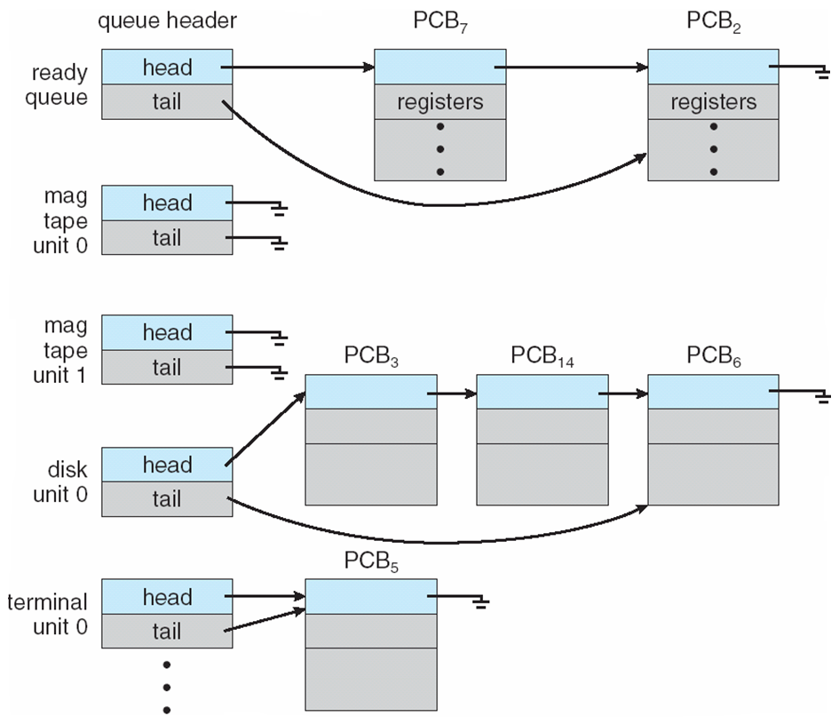
SRM
INSTITUTE OF SCIENCE AND TECHNOLOGY,
CHENNAI.
Ready Queue And Various I/O Device Queues

Slide 53
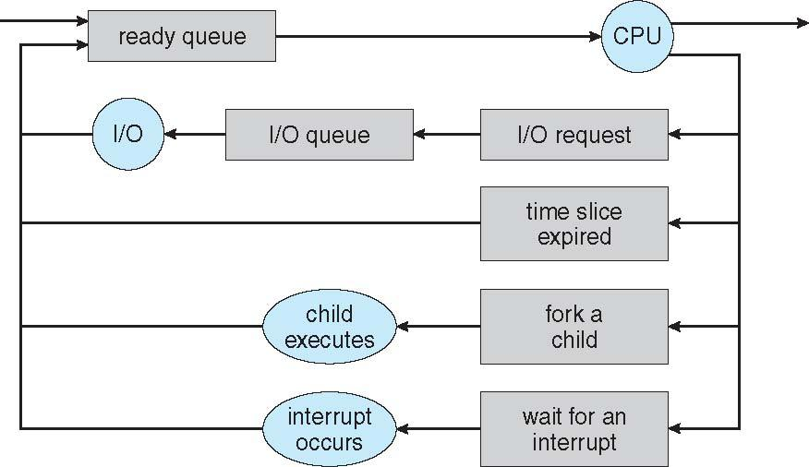
SRM
INSTITUTE OF SCIENCE AND TECHNOLOGY,
CHENNAI.
Representation of Process Scheduling
Queueing diagram represents queues, resources, flows

Slide 54
SRM
INSTITUTE OF SCIENCE AND TECHNOLOGY,
CHENNAI.
Schedulers
Short-term scheduler (or CPU scheduler) – selects which process should be executed next and allocates CPU
Sometimes the only scheduler in a system
Short-term scheduler is invoked frequently (milliseconds) ⇒ (must be fast)
Long-term scheduler (or job scheduler) – selects which processes should be brought into the ready queue
Long-term scheduler is invoked infrequently (seconds, minutes) ⇒ (may be slow)
The long-term scheduler controls the degree of multiprogramming
Processes can be described as either:
I/O-bound process – spends more time doing I/O than computations, many short CPU bursts
CPU-bound process – spends more time doing computations; few very long CPU bursts
Long-term scheduler strives for good process mix

Slide 55
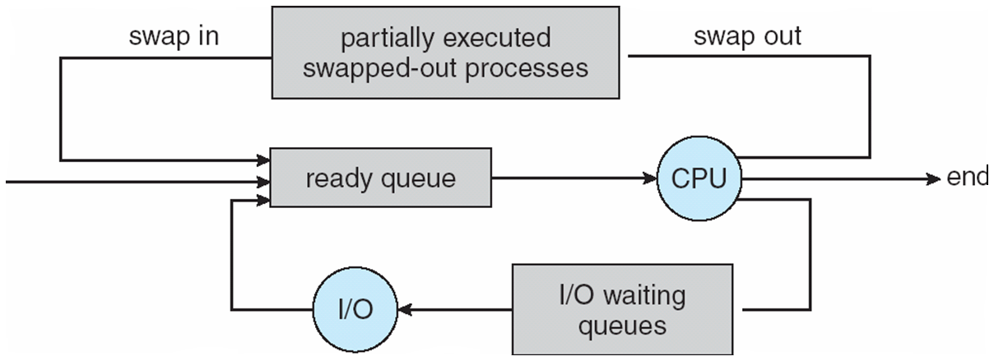
SRM
INSTITUTE OF SCIENCE AND TECHNOLOGY,
CHENNAI.
Addition of Medium Term Scheduling
Medium-term scheduler can be added if degree of multiple programming needs to decrease
Remove process from memory, store on disk, bring back in from disk to continue execution: swapping

Slide 56
SRM
INSTITUTE OF SCIENCE AND TECHNOLOGY,
CHENNAI.
Multitasking in Mobile Systems
Some mobile systems (e.g., early version of iOS) allow only one process to run, others suspended
Due to screen real estate, user interface limits iOS provides for a
Single foreground process- controlled via user interface
Multiple background processes– in memory, running, but not on the display, and with limits
Limits include single, short task, receiving notification of events, specific long-running tasks like audio playback
Android runs foreground and background, with fewer limits
Background process uses a service to perform tasks
Service can keep running even if background process is suspended
Service has no user interface, small memory use

Slide 57
SRM
INSTITUTE OF SCIENCE AND TECHNOLOGY,
CHENNAI.
Context Switch
When CPU switches to another process, the system must save the state of the old process and load the saved state for the new process via a context switch
Context of a process represented in the PCB
Context-switch time is overhead; the system does no useful work while switching
The more complex the OS and the PCB 🡺 the longer the context switch
Time dependent on hardware support
Some hardware provides multiple sets of registers per CPU 🡺 multiple contexts loaded at once

Slide 58
SRM
INSTITUTE OF SCIENCE AND TECHNOLOGY,
CHENNAI.
Operations on Processes
System must provide mechanisms for:
process creation,
process termination,
and so on as detailed next

Slide 59
SRM
INSTITUTE OF SCIENCE AND TECHNOLOGY,
CHENNAI.
Process Creation
Parent process create children processes, which, in turn create other processes, forming a tree of processes
Generally, process identified and managed via a process identifier (pid)
Resource sharing options
Parent and children share all resources
Children share subset of parent’s resources
Parent and child share no resources
Execution options
Parent and children execute concurrently
Parent waits until children terminate

Slide 60
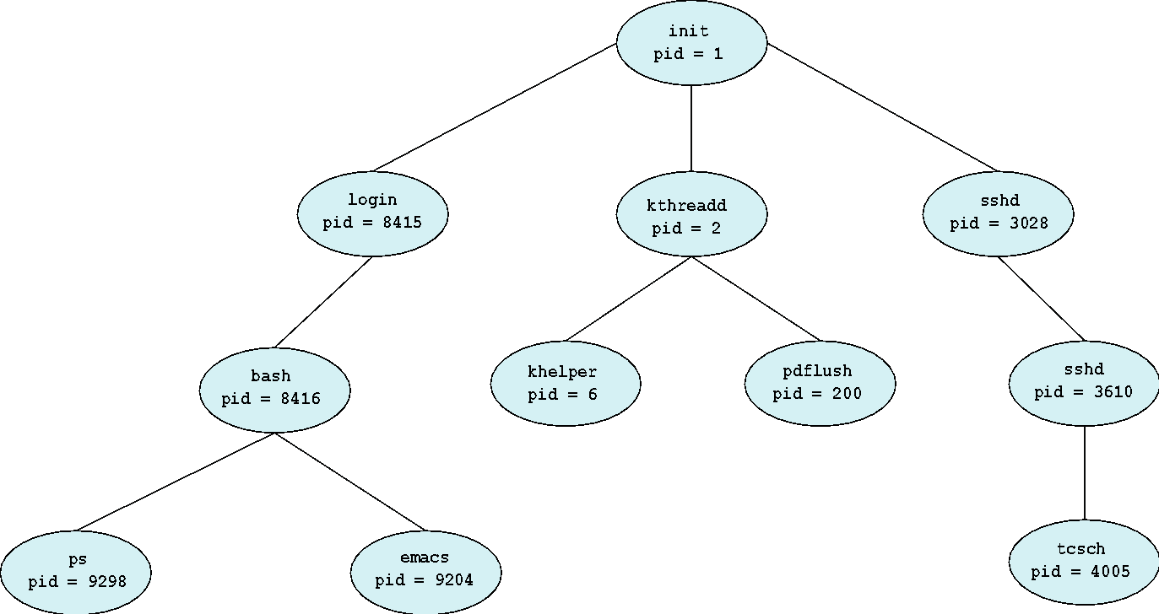
SRM
INSTITUTE OF SCIENCE AND TECHNOLOGY,
CHENNAI.
A Tree of Processes in Linux

Slide 61
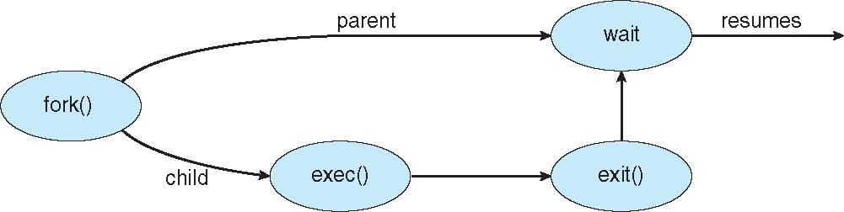
SRM
INSTITUTE OF SCIENCE AND TECHNOLOGY,
CHENNAI.
Process Creation (Cont.)
Address space
Child duplicate of parent
Child has a program loaded into it
UNIX examples
fork() system call creates new process
exec() system call used after a fork() to replace the process’ memory space with a new program

Slide 62
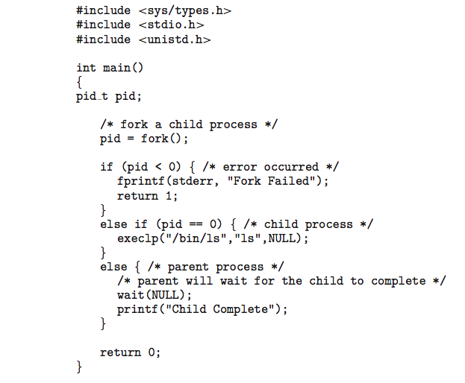
SRM
INSTITUTE OF SCIENCE AND TECHNOLOGY,
CHENNAI.
C Program Forking Separate Process

Slide 63
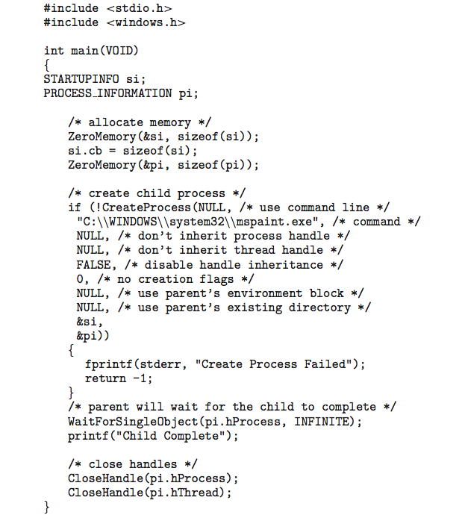
SRM
INSTITUTE OF SCIENCE AND TECHNOLOGY,
CHENNAI.
Creating a Separate Process via Windows API

Slide 64
SRM
INSTITUTE OF SCIENCE AND TECHNOLOGY,
CHENNAI.
Process Termination
Process executes last statement and then asks the operating system to delete it using the exit() system call.
Returns status data from child to parent (via wait())
Process’ resources are deallocated by operating system
Parent may terminate the execution of children processes using the abort() system call. Some reasons for doing so:
Child has exceeded allocated resources
Task assigned to child is no longer required
The parent is exiting and the operating systems does not allow a child to continue if its parent terminates

Slide 65
SRM
INSTITUTE OF SCIENCE AND TECHNOLOGY,
CHENNAI.
Process Termination
Some operating systems do not allow child to exists if its parent has terminated. If a process terminates, then all its children must also be terminated.
cascading termination. All children, grandchildren, etc. are terminated.
The termination is initiated by the operating system.
The parent process may wait for termination of a child process by using the wait()system call. The call returns status information and the pid of the terminated process
pid = wait(&status);
If no parent waiting (did not invoke wait()) process is a zombie
If parent terminated without invoking wait , process is an orphan

Slide 66
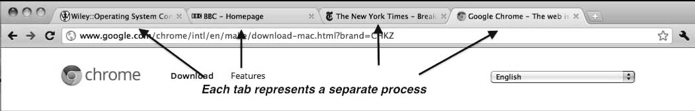
SRM
INSTITUTE OF SCIENCE AND TECHNOLOGY,
CHENNAI.
Multiprocess Architecture – Chrome Browser
Many web browsers ran as single process (some still do)
If one web site causes trouble, entire browser can hang or crash
Google Chrome Browser is multiprocess with 3 different types of processes:
Browser process manages user interface, disk and network I/O
Renderer process renders web pages, deals with HTML, Javascript. A new renderer created for each website opened
Runs in sandbox restricting disk and network I/O, minimizing effect of security exploits
Plug-in process for each type of plug-in

Slide 67
SRM
INSTITUTE OF SCIENCE AND TECHNOLOGY,
CHENNAI.
Interprocess Communication
Processes within a system may be independent or cooperating
Cooperating process can affect or be affected by other processes, including sharing data
Reasons for cooperating processes:
Information sharing
Computation speedup
Modularity
Convenience
Cooperating processes need interprocess communication (IPC)
Two models of IPC
Shared memory
Message passing

Slide 68
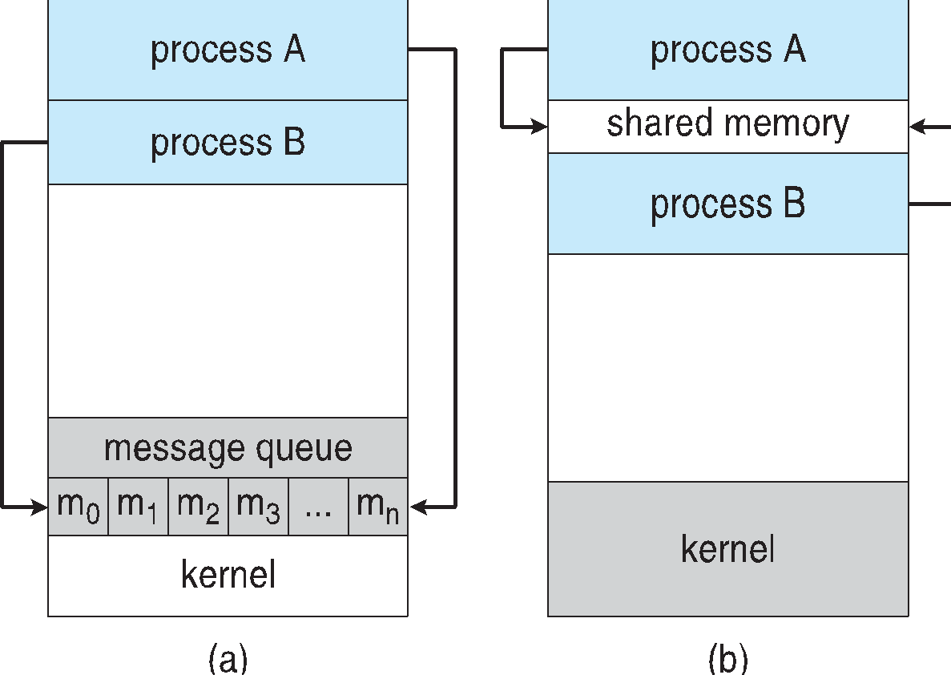
SRM
INSTITUTE OF SCIENCE AND TECHNOLOGY,
CHENNAI.
Communications Models
(a) Message passing. (b) shared memory.

Slide 69
SRM
INSTITUTE OF SCIENCE AND TECHNOLOGY,
CHENNAI.
Cooperating Processes
Independent process cannot affect or be affected by the execution of another process
Cooperating process can affect or be affected by the execution of another process
Advantages of process cooperation
Information sharing
Computation speed-up
Modularity
Convenience

Slide 70
SRM
INSTITUTE OF SCIENCE AND TECHNOLOGY,
CHENNAI.
Producer-Consumer Problem
Paradigm for cooperating processes, producer process produces information that is consumed by a consumer process
unbounded-buffer places no practical limit on the size of the buffer
bounded-buffer assumes that there is a fixed buffer size

Slide 71
SRM
INSTITUTE OF SCIENCE AND TECHNOLOGY,
CHENNAI.
Bounded-Buffer – Shared-Memory Solution
Shared data
#define BUFFER_SIZE 10
typedef struct {
. . .
} item;
item buffer[BUFFER_SIZE];
int in = 0;
int out = 0;
Solution is correct, but can only use BUFFER_SIZE-1 elements

Slide 72
SRM
INSTITUTE OF SCIENCE AND TECHNOLOGY,
CHENNAI.
Bounded-Buffer – Producer
item next_produced;
while (true) {
/* produce an item in next produced */
while (((in + 1) % BUFFER_SIZE) == out)
; /* do nothing */
buffer[in] = next_produced;
in = (in + 1) % BUFFER_SIZE;
}

Slide 73
SRM
INSTITUTE OF SCIENCE AND TECHNOLOGY,
CHENNAI.
Bounded Buffer – Consumer
item next_consumed;
while (true) { while (in == out)
; /* do nothing */ next_consumed = buffer[out];
out = (out + 1) % BUFFER_SIZE;
/* consume the item in next consumed */
}

Slide 74
SRM
INSTITUTE OF SCIENCE AND TECHNOLOGY,
CHENNAI.
Interprocess Communication – Shared Memory
An area of memory shared among the processes that wish to communicate
The communication is under the control of the users processes not the operating system.
Major issues is to provide mechanism that will allow the user processes to synchronize their actions when they access shared memory.
Synchronization is discussed in great details in Chapter 5.

Slide 75
SRM
INSTITUTE OF SCIENCE AND TECHNOLOGY,
CHENNAI.
Interprocess Communication – Message Passing
Mechanism for processes to communicate and to synchronize their actions
Message system – processes communicate with each other without resorting to shared variables
IPC facility provides two operations:
send(message)
receive(message)
The message size is either fixed or variable

Slide 76
SRM
INSTITUTE OF SCIENCE AND TECHNOLOGY,
CHENNAI.
Message Passing (Cont.)
If processes P and Q wish to communicate, they need to:
Establish a communication link between them
Exchange messages via send/receive
Implementation issues:
How are links established?
Can a link be associated with more than two processes?
How many links can there be between every pair of communicating processes?
What is the capacity of a link?
Is the size of a message that the link can accommodate fixed or variable?
Is a link unidirectional or bi-directional?

Slide 77
SRM
INSTITUTE OF SCIENCE AND TECHNOLOGY,
CHENNAI.
Message Passing (Cont.)
Implementation of communication link
Physical:
Shared memory
Hardware bus
Network
Logical:
Direct or indirect
Synchronous or asynchronous
Automatic or explicit buffering

Slide 78
SRM
INSTITUTE OF SCIENCE AND TECHNOLOGY,
CHENNAI.
Examples of IPC Systems - POSIX
POSIX Shared Memory
Process first creates shared memory segment shm_fd = shm_open(name, O CREAT | O RDWR, 0666);
Also used to open an existing segment to share it
Set the size of the object
ftruncate(shm fd, 4096);
Now the process could write to the shared memory
sprintf(shared memory, "Writing to shared memory");

Slide 79
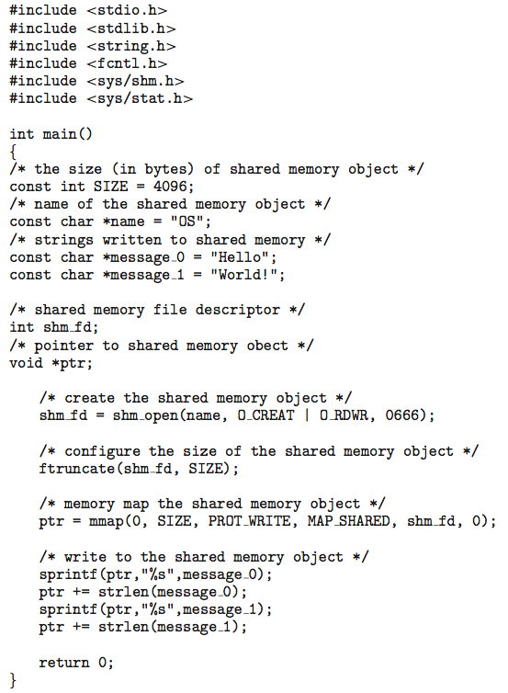
SRM
INSTITUTE OF SCIENCE AND TECHNOLOGY,
CHENNAI.
IPC POSIX Producer

Slide 80
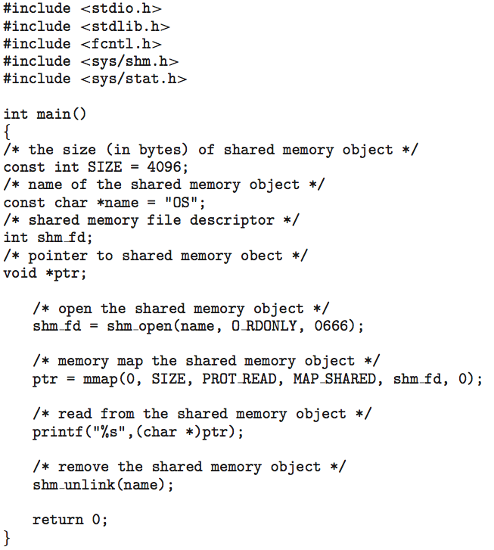
SRM
INSTITUTE OF SCIENCE AND TECHNOLOGY,
CHENNAI.
IPC POSIX Consumer

Slide 81
SRM
INSTITUTE OF SCIENCE AND TECHNOLOGY,
CHENNAI.
Examples of IPC Systems - Mach
Mach communication is message based
Even system calls are messages
Each task gets two mailboxes at creation- Kernel and Notify
Only three system calls needed for message transfer
msg_send(), msg_receive(), msg_rpc()
Mailboxes needed for commuication, created via
port_allocate()
Send and receive are flexible, for example four options if mailbox full:
Wait indefinitely
Wait at most n milliseconds
Return immediately
Temporarily cache a message

Slide 82
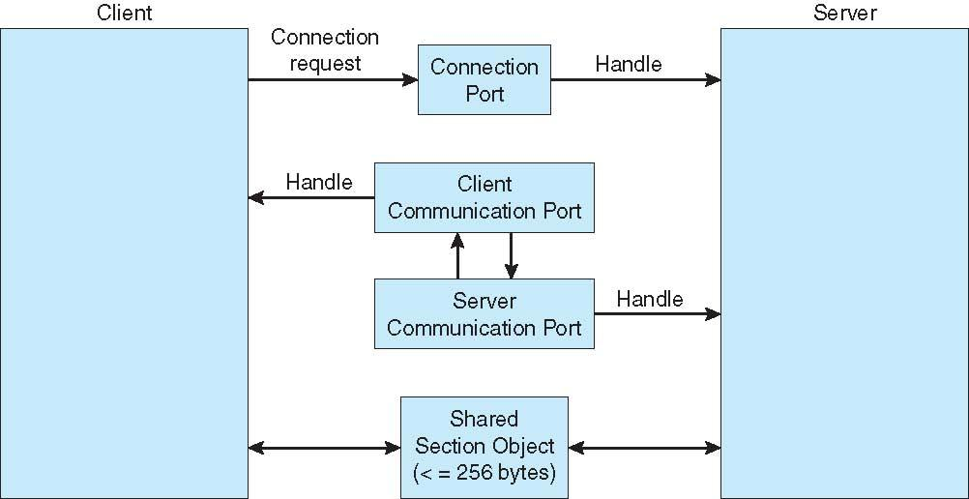
SRM
INSTITUTE OF SCIENCE AND TECHNOLOGY,
CHENNAI.
Local Procedure Calls in Windows

Slide 83
SRM
INSTITUTE OF SCIENCE AND TECHNOLOGY,
CHENNAI.
Pipes
Acts as a conduit allowing two processes to communicate
Issues:
Is communication unidirectional or bidirectional?
In the case of two-way communication, is it half or full-duplex?
Must there exist a relationship (i.e., parent-child) between the communicating processes?
Can the pipes be used over a network?
Ordinary pipes – cannot be accessed from outside the process that created it. Typically, a parent process creates a pipe and uses it to communicate with a child process that it created.
Named pipes – can be accessed without a parent-child relationship.

Slide 84
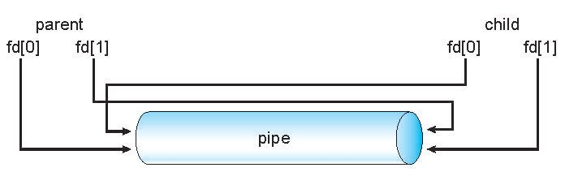
SRM
INSTITUTE OF SCIENCE AND TECHNOLOGY,
CHENNAI.
Ordinary Pipes
Ordinary Pipes allow communication in standard producer-consumer style
Producer writes to one end (the write-end of the pipe)
Consumer reads from the other end (the read-end of the pipe)
Ordinary pipes are therefore unidirectional
Require parent-child relationship between communicating processes
Windows calls these anonymous pipes
See Unix and Windows code samples in textbook

Slide 85
SRM
INSTITUTE OF SCIENCE AND TECHNOLOGY,
CHENNAI.
Named Pipes
Named Pipes are more powerful than ordinary pipes
Communication is bidirectional
No parent-child relationship is necessary between the communicating processes
Several processes can use the named pipe for communication
Provided on both UNIX and Windows systems

Slide 86
SRM
INSTITUTE OF SCIENCE AND TECHNOLOGY,
CHENNAI.
Process Synchronization
Process Synchronization means sharing system resources by processes in a such a way that, Concurrent access to shared data is handled thereby minimizing the chance of inconsistent data. Maintaining data consistency demands mechanisms to ensure synchronized execution of cooperating processes.
In other ways,
Processes can execute concurrently
May be interrupted at any time, partially completing execution
Concurrent access to shared data may result in data inconsistency
Maintaining data consistency requires mechanisms to ensure the orderly execution of cooperating processes
Illustration of the problem:
Suppose that we wanted to provide a solution to the consumer-producer problem that fills all the buffers. We can do so by having an integer counter that keeps track of the number of full buffers. Initially, counter is set to 0. It is incremented by the producer after it produces a new buffer and is decremented by the consumer after it consumes a buffer.

Slide 87
Producer
SRM
INSTITUTE OF SCIENCE AND TECHNOLOGY,
CHENNAI.
Consumer
while (true) { /* produce an item in next produced */
while (counter == BUFFER_SIZE) ;
/* do nothing */
buffer[in] = next_produced;
in = (in + 1) % BUFFER_SIZE;
counter++;
}
while (true) {
while (counter == 0)
; /* do nothing */
next_consumed = buffer[out];
out = (out + 1) % BUFFER_SIZE;
counter--;
/* consume the item in next consumed */
}

Slide 88
SRM
INSTITUTE OF SCIENCE AND TECHNOLOGY,
CHENNAI.
Race Condition
Occurs when multiple processes or threads read and write shared data items
The final result depends on the order of execution
the “loser” of the race is the process that updates last and will determine the final value of the variable

Slide 89
SRM
INSTITUTE OF SCIENCE AND TECHNOLOGY,
CHENNAI.
Race Condition
Assume P1 and P2 are executing this code and share the variable a
Processes can be preempted at any time.
Assume P1 is preempted after the input statement, and P2 then executes entirely
The character echoed by P1 will be the one read by P2 !!
static char a;
void echo()
{
cin >> a;
cout << a;
}
This is an example of a race condition
Individual processes (threads) execute sequentially in isolation, but concurrency causes them to interact.
We need to prevent concurrent execution by processes when they are changing the same data. We need to enforce mutual exclusion.

Slide 90
SRM
INSTITUTE OF SCIENCE AND TECHNOLOGY,
CHENNAI.
Critical Section Problem
When a process executes code that manipulates shared data (or resources), we say that the process is in its critical section (CS) for that shared data
We must enforce mutual exclusion on the execution of critical sections.
Only one process at a time can be in its CS (for that shared data or resource).
Each process must ask permission to enter critical section in entry section, may follow critical section with exit section, then remainder section

Slide 91
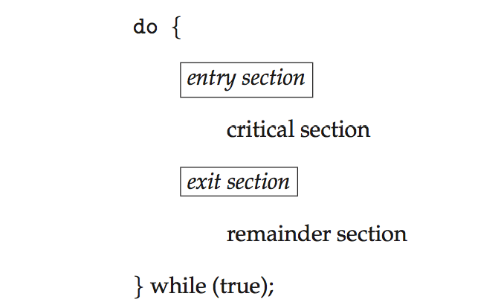
SRM
INSTITUTE OF SCIENCE AND TECHNOLOGY,
CHENNAI.
Critical Section
General structure of process P_{i}

Slide 92
SRM
INSTITUTE OF SCIENCE AND TECHNOLOGY,
CHENNAI.
Solution to Critical-Section Problem
1. Mutual Exclusion - If process P_{i} is executing in its critical section, then no other processes can be executing in their critical sections
2. Progress - If no process is executing in its critical section and there exist some processes that wish to enter their critical section, then the selection of the processes that will enter the critical section next cannot be postponed indefinitely
3. Bounded Waiting - A bound must exist on the number of times that other processes are allowed to enter their critical sections after a process has made a request to enter its critical section and before that request is granted
Assume that each process executes at a nonzero speed
No assumption concerning relative speed of the n processes

Slide 93
SRM INSTITUTE OF SCIENCE AND TECHNOLOGY,
CHENNAI.
Critical-Section Handling in OS
Two approaches depending on if kernel is preemptive or non- preemptive
Preemptive – allows preemption of process when running in kernel mode
Non-preemptive – runs until exits kernel mode, blocks, or voluntarily yields CPU
Essentially free of race conditions in kernel mode

Slide 94
SRM
INSTITUTE OF SCIENCE AND TECHNOLOGY,
CHENNAI.
References:
1. Abraham Silberschatz, Peter Baer Galvin, Greg Gagne, Operating systems, 9th ed., John Wiley & Sons, 2013
2. William Stallings, Operating Systems-Internals and Design Principles, 7th ed., Prentice Hall, 2012

Slide 95
SRM
INSTITUTE OF SCIENCE AND TECHNOLOGY,
CHENNAI.
Thank You !!!

